Slide 1
Portfolio Slide Deck

Slide 2
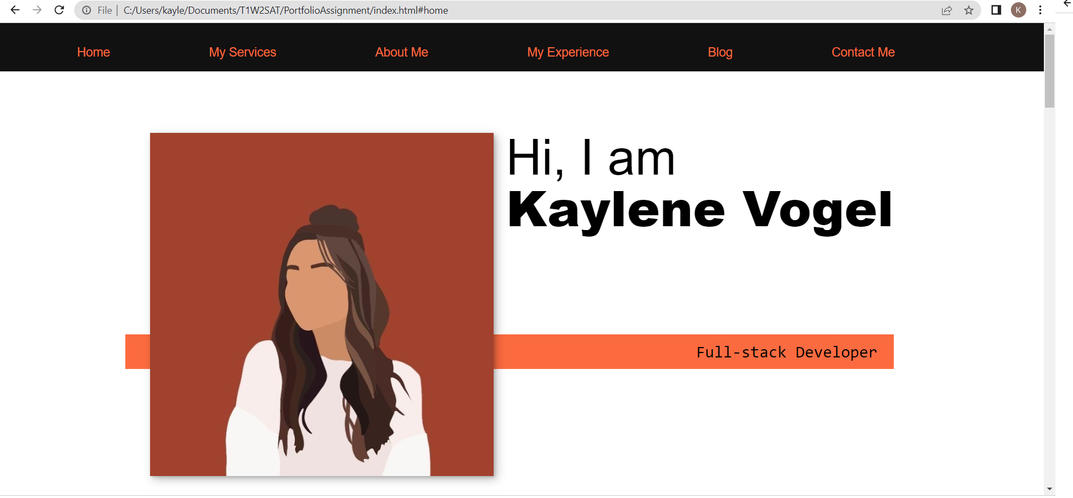
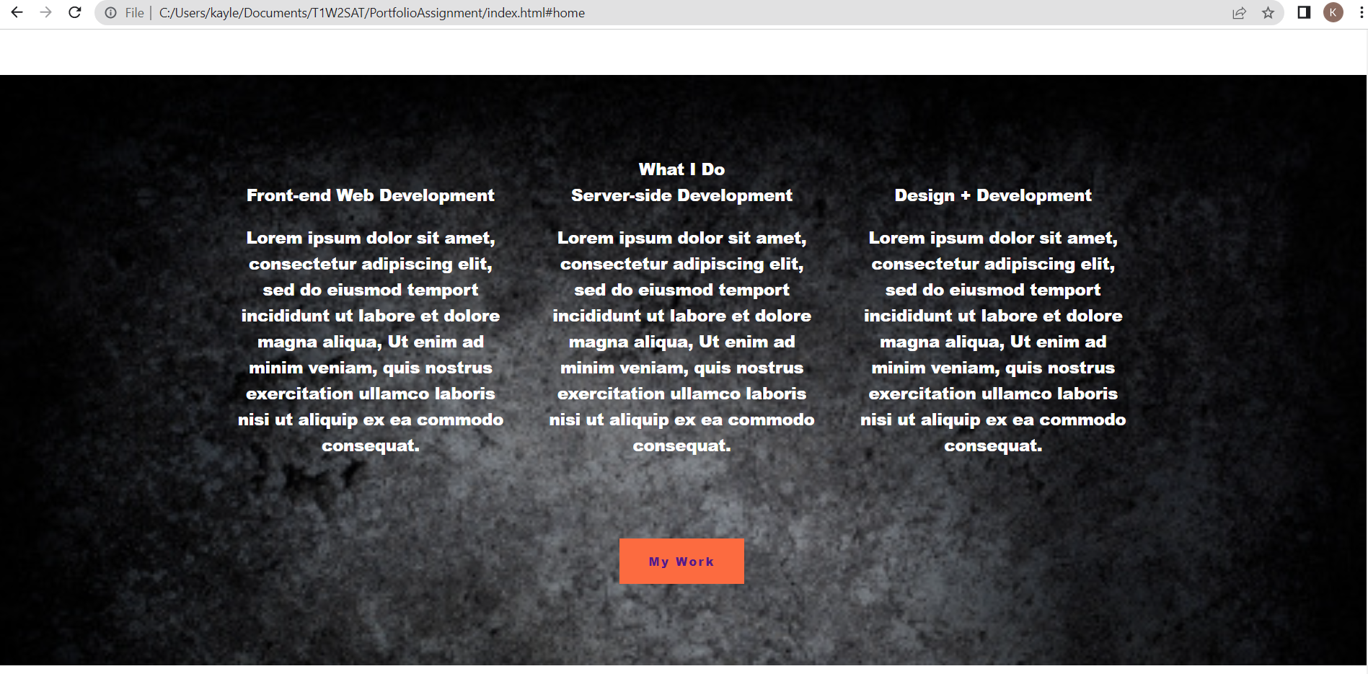
Website Overview
My portfolio website features;
Home
My Services
About me
My experience
Blog & contact me section.
It also has links to social platforms & a PDF resume
The navigation bar is easy to read and has a highlight feature when hovering over the menu.
Clicking on the menu item will take you directly to the section of the page you requested.

Slide 3
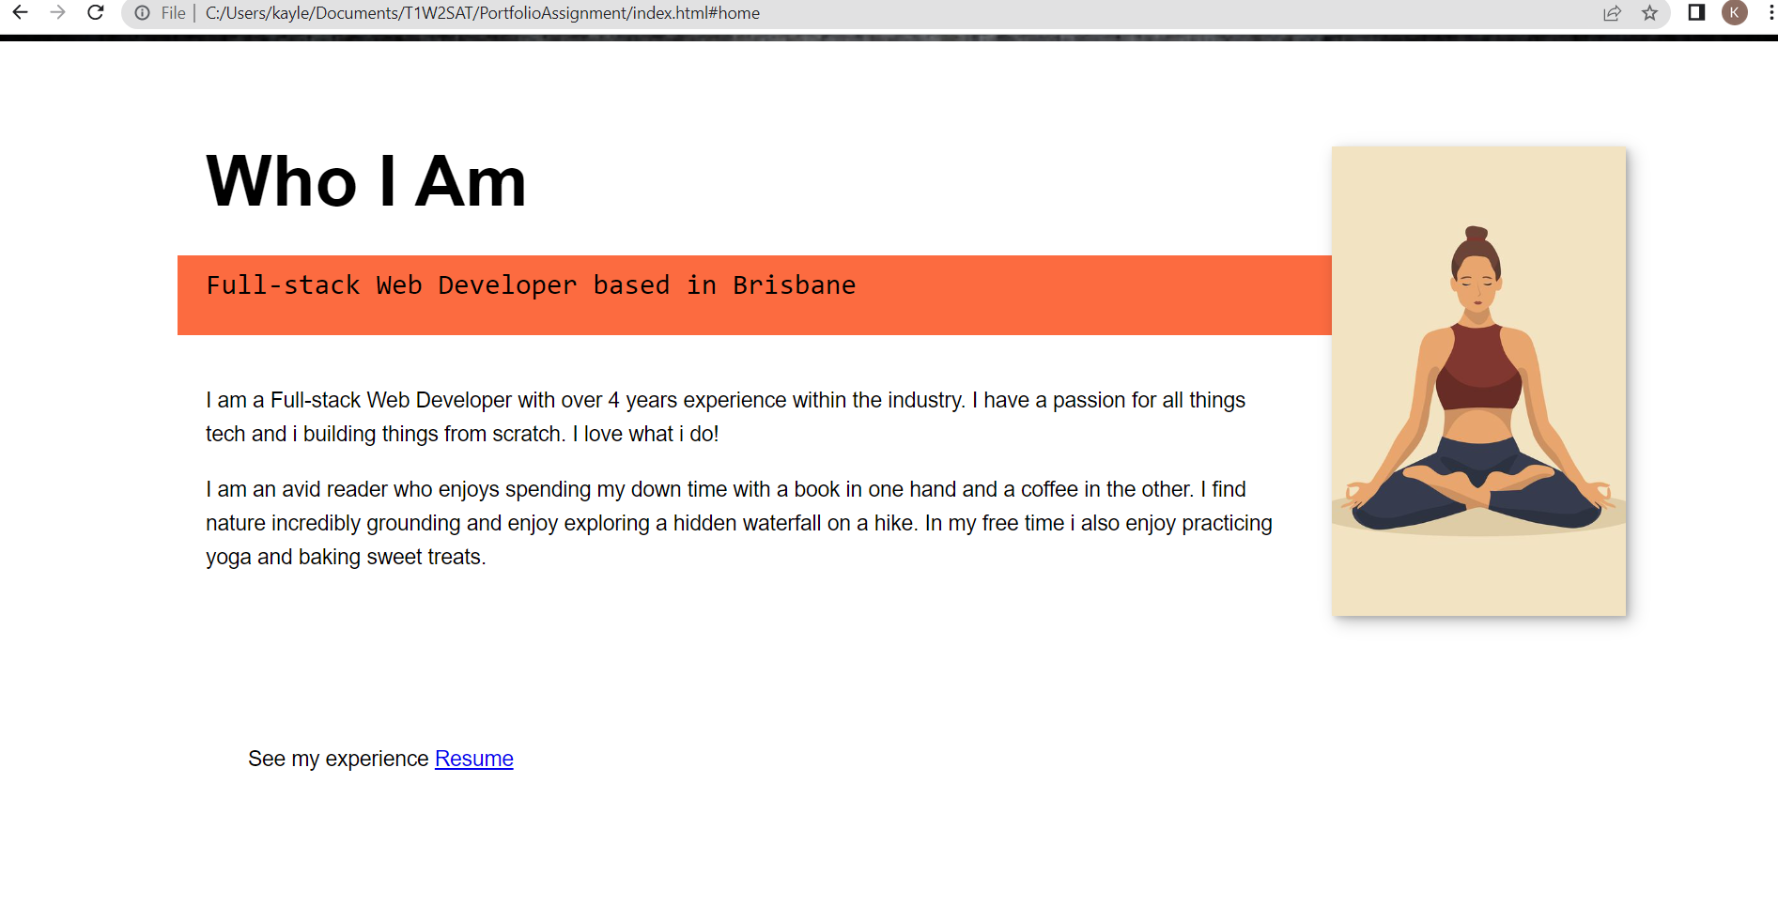
Who am I
This section describes a brief overview of my experience
It also gives my clients some insight into who I am & what I do in my free time to make it feel more personal.

Slide 4
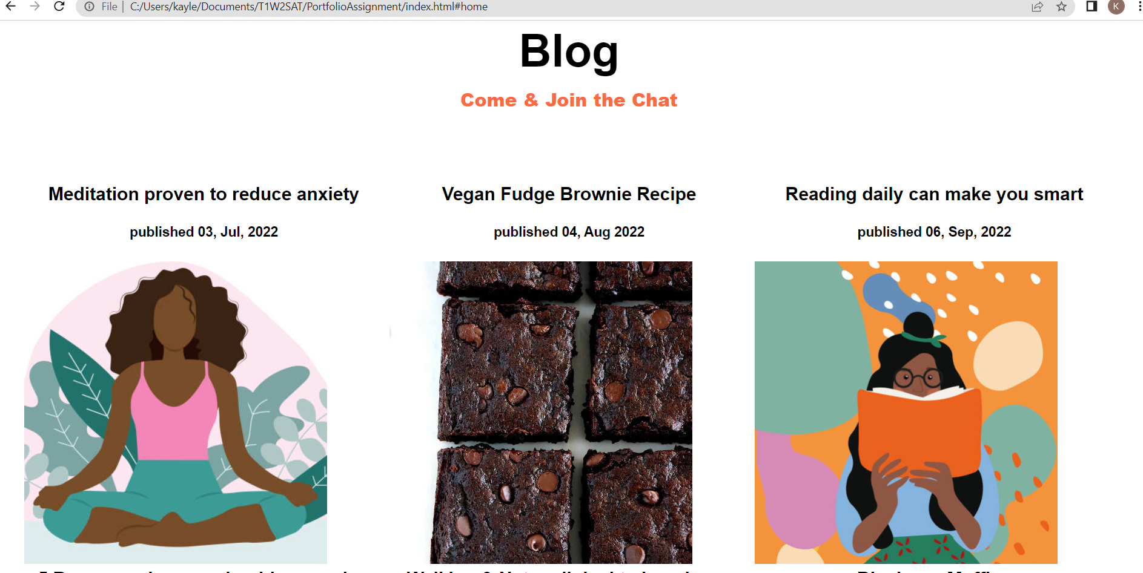
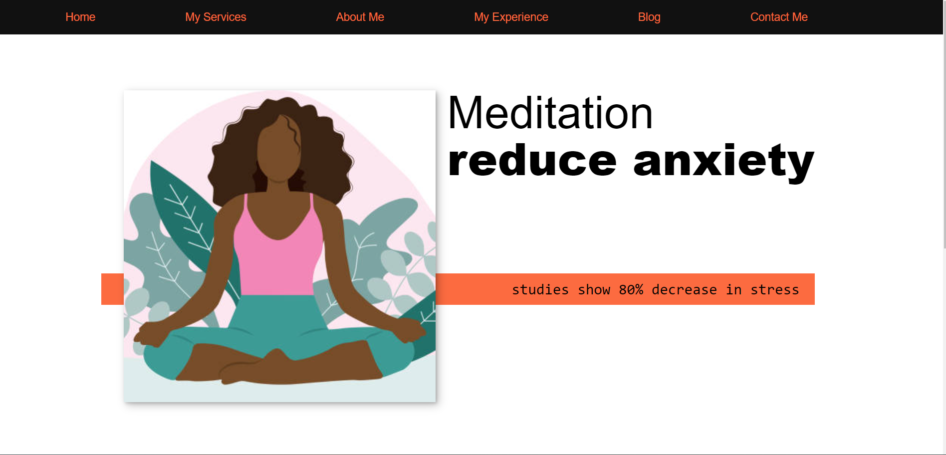
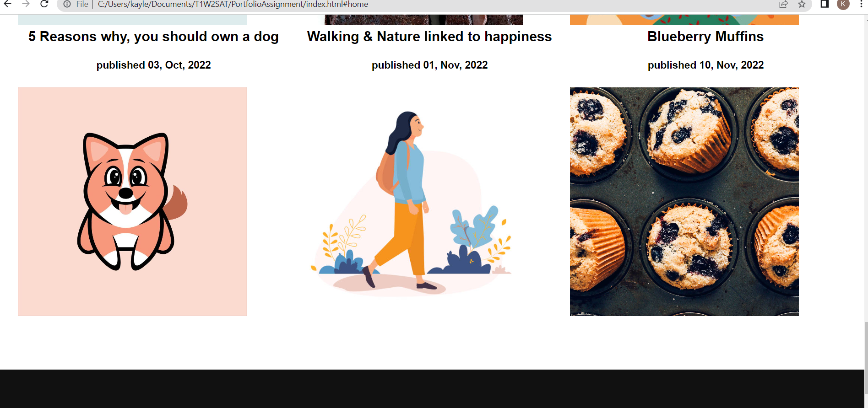
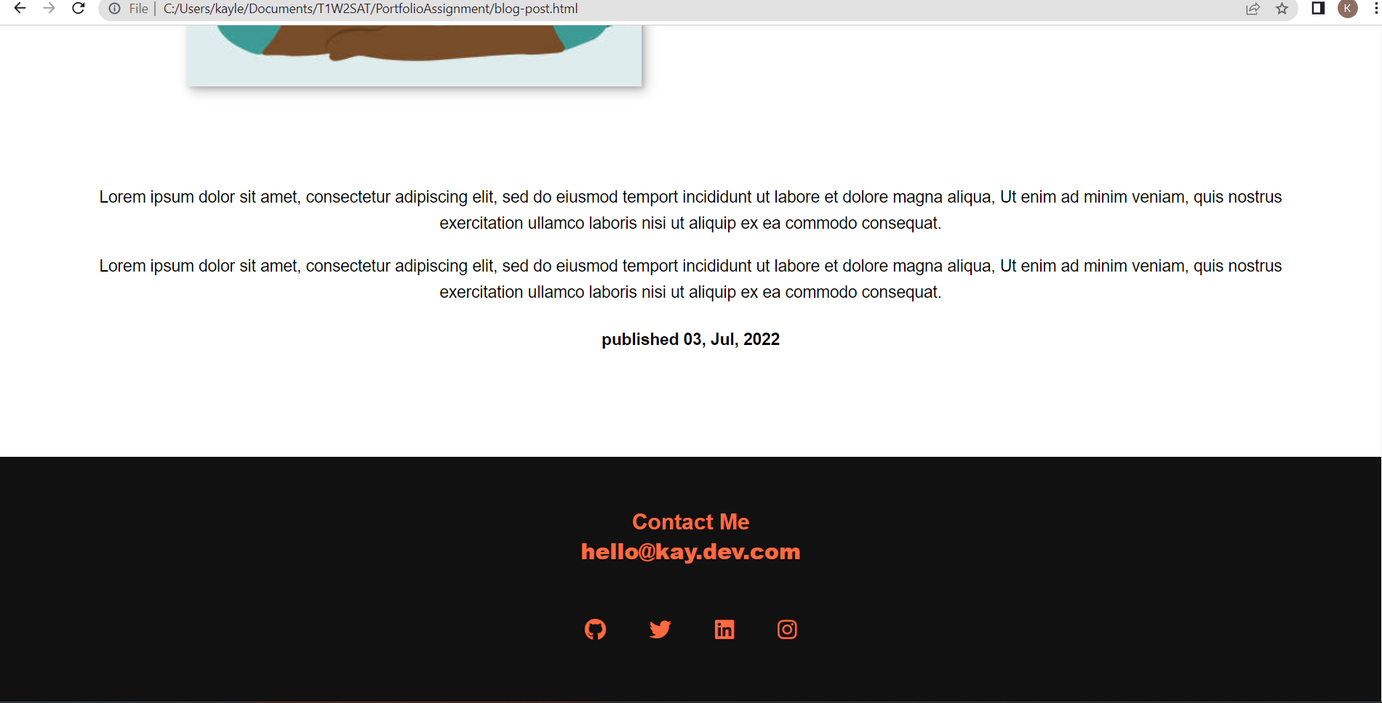
Blog
The blog section features x6 blog articles that all link to another page to read the full article.
The posts all have a published date & access to the full navigation bar & social links/ contact details.

Slide 5
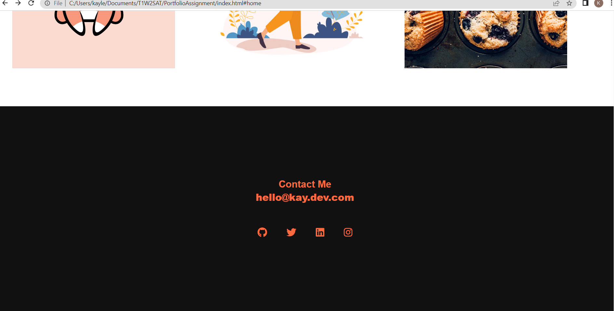
Contact Details & Social Links
This section features an email address,
Links to; GitHub, twitter, LinkedIn & Instagram
It also offers a hover over feature so clients can easily see which icon they want to click

Slide 6
Development process
For my portfolio, I wanted to make it easy to navigate,
also obvious what I do & what sort of services I offer.
I used the layout with the scroll down feature as it felt less messy then jumping around to different pages.
I also took into account the menu bar should navigate directly to the section of the website the client is looking for.
I found challenges with images, sizing & getting them to fit correctly to the page with CSS but fondly enough I enjoyed the styling of the website the most. Once I got the hang of what I was doing it was really fun.
I found challenges at the end with Netlify accepting images, however they show and load on my direct link to the website.

Slide 7
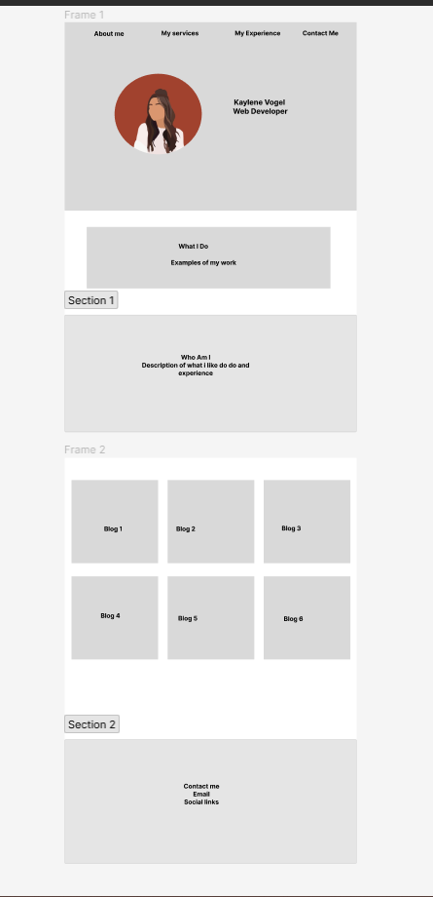
Wireframes
This is how I originally designed my website & I
pretty much stayed with this design and layout bar some more
Graphical changes as started my project.
I new I would be going with a burnt orange/ apricot pink theme with some black & stuck with that.

